Slide 1
Image Recommendation
By Fynn Davis

Slide 2
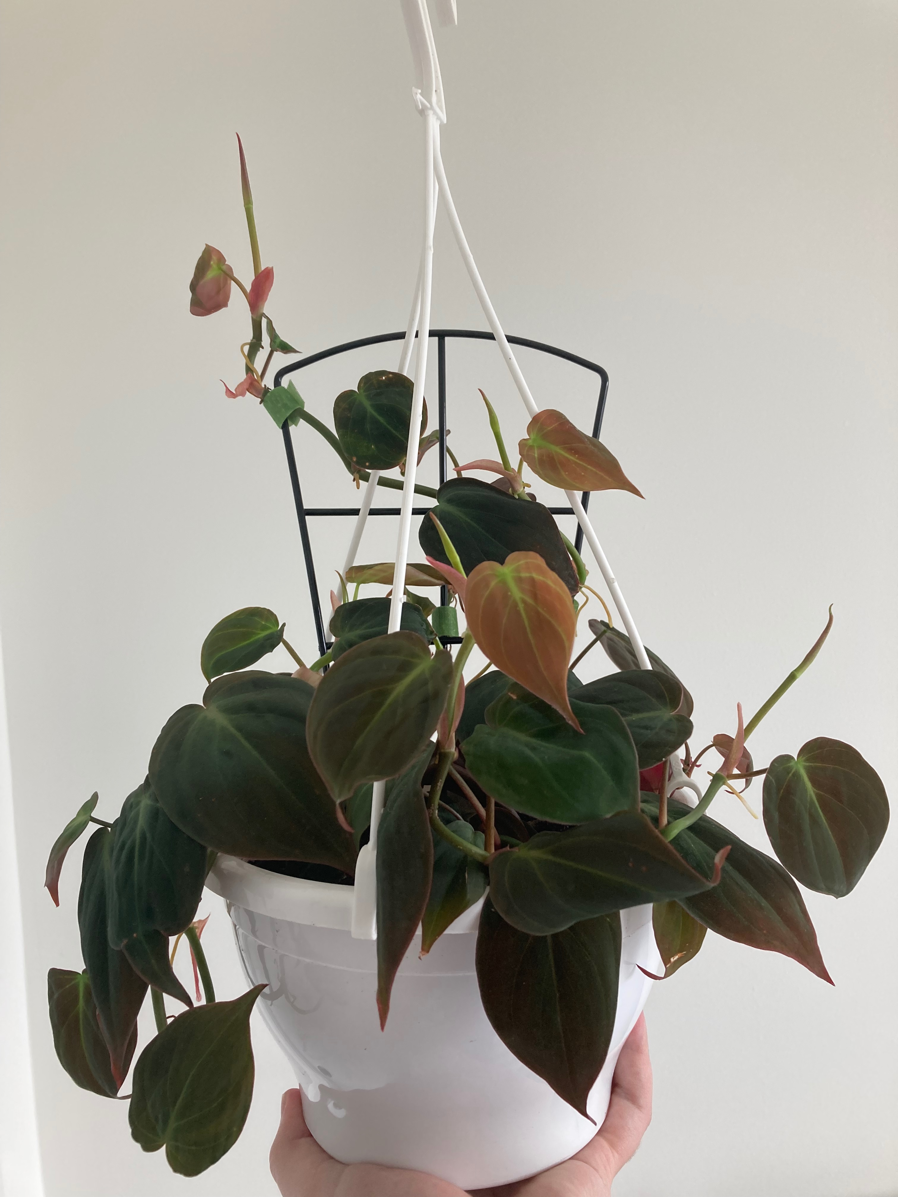
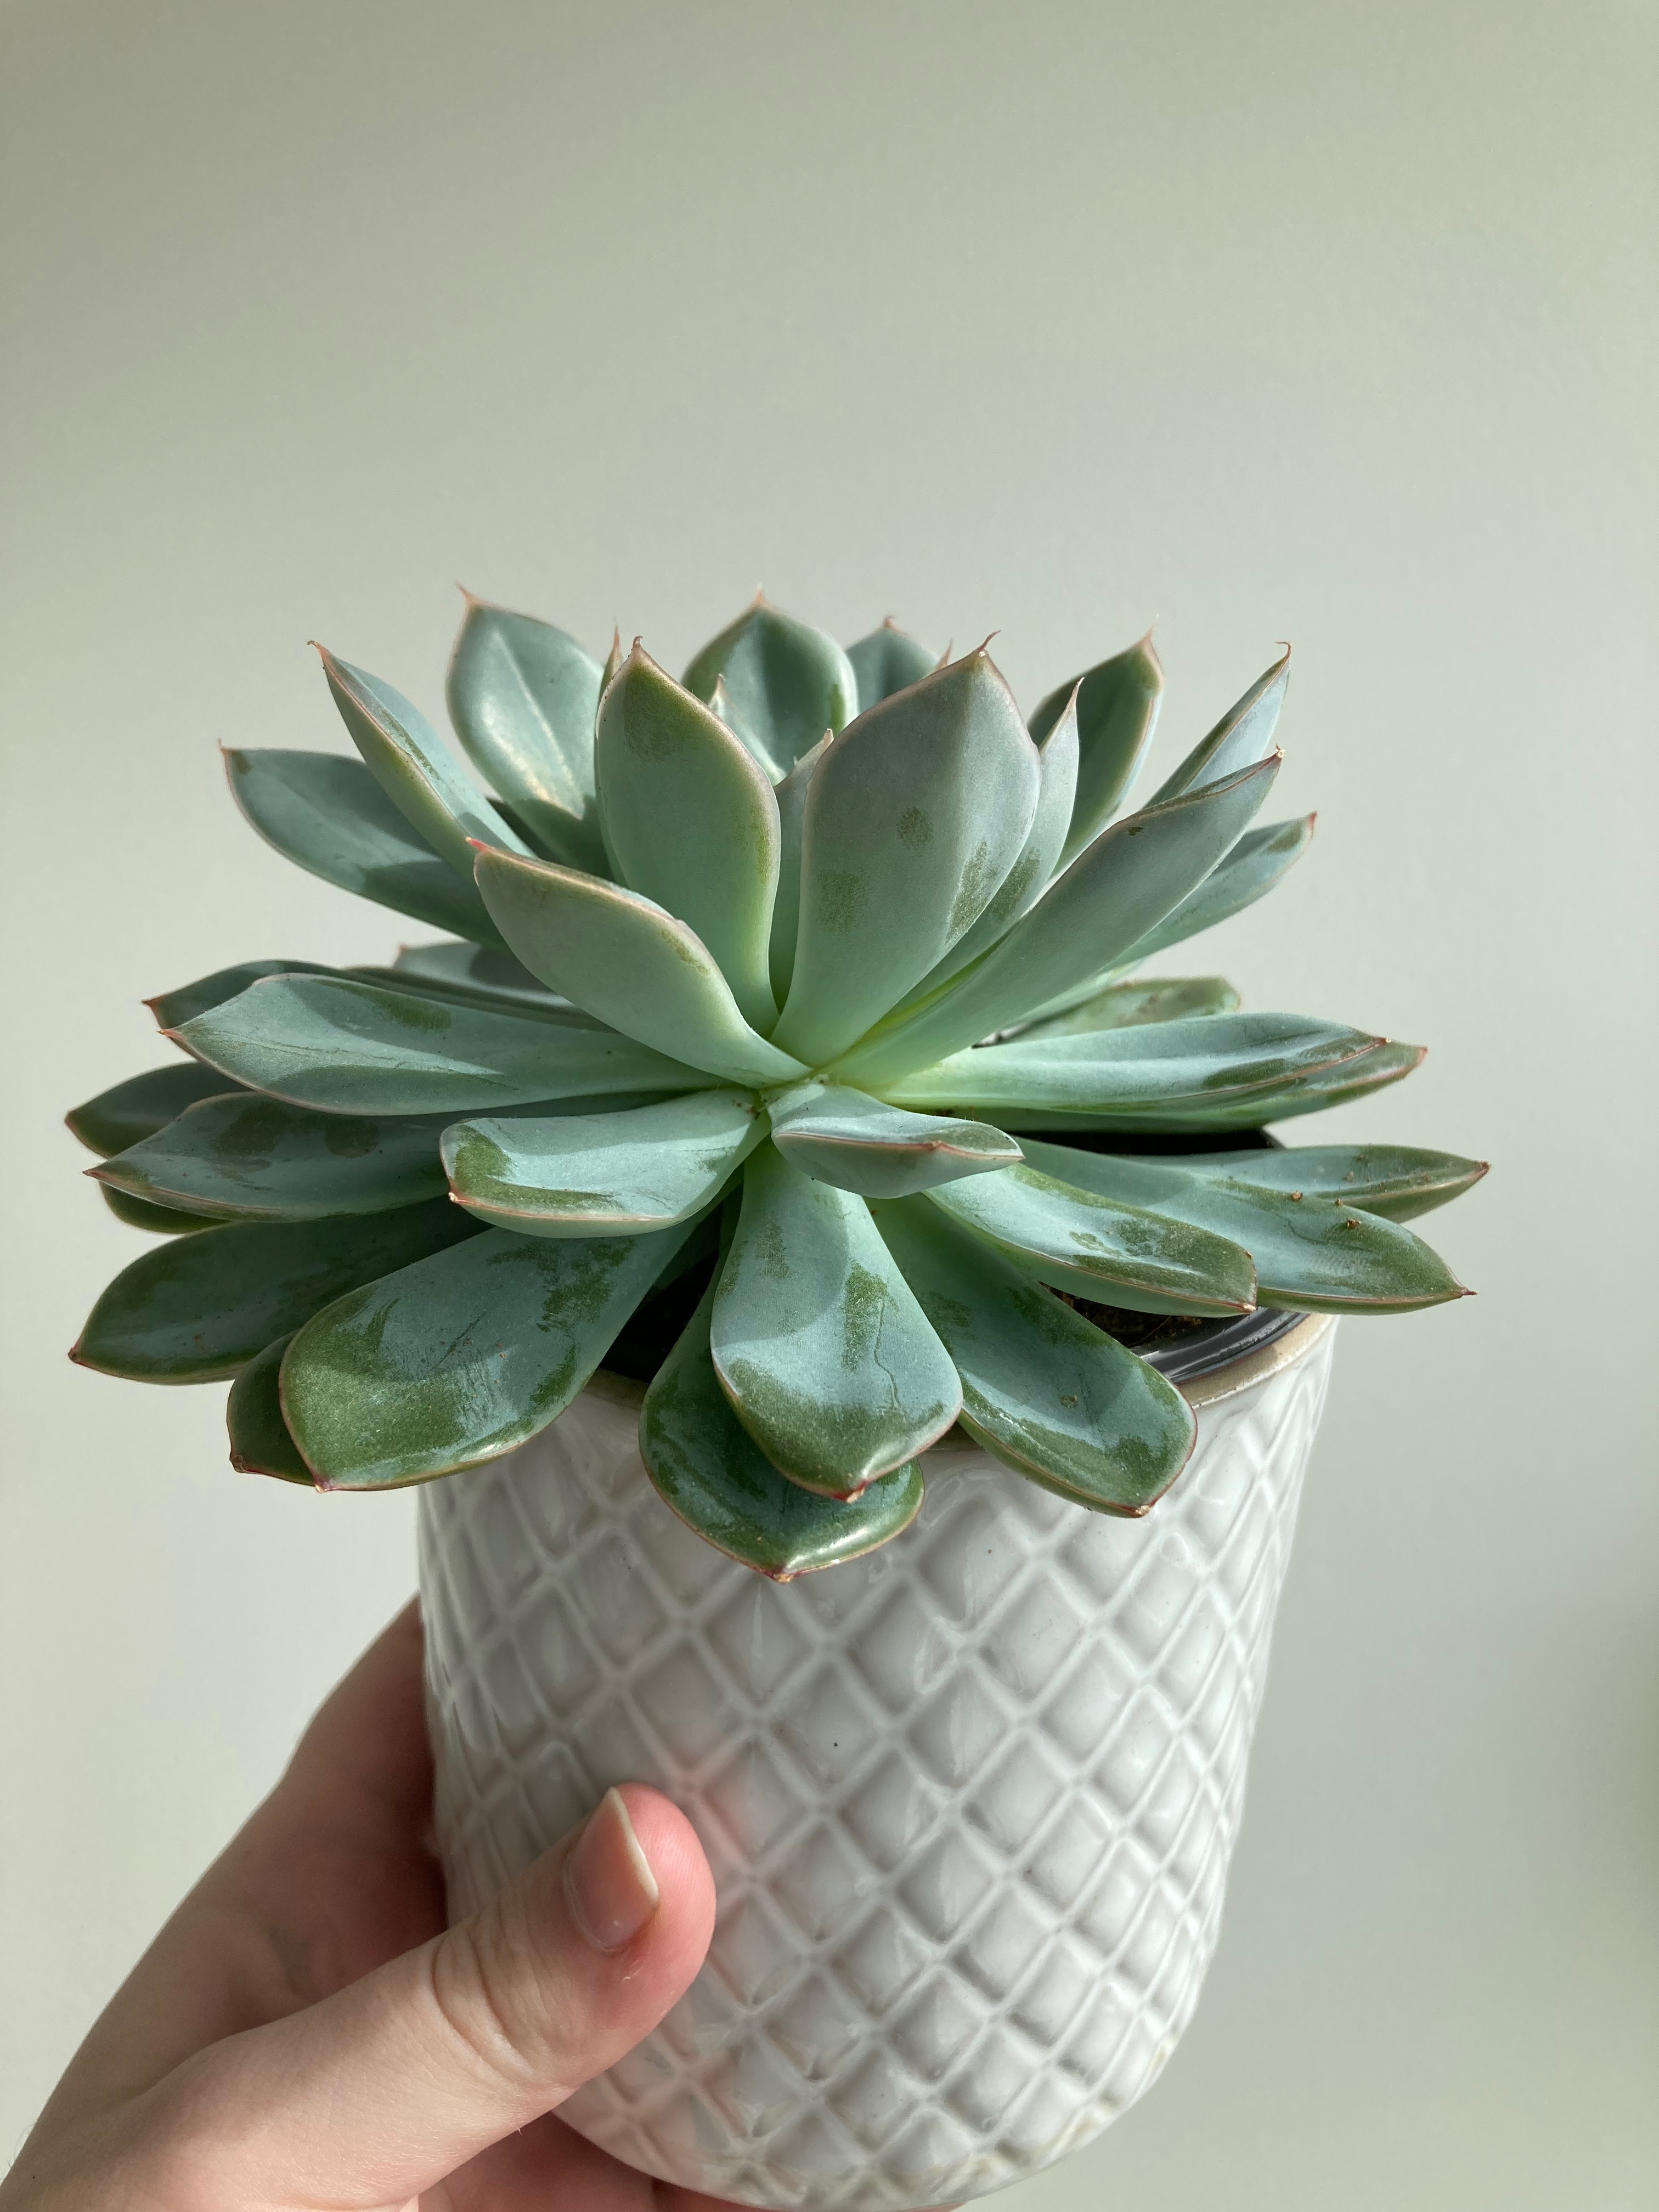
Goal
Notes:
Motivation: love image social media, plants the last year
Product goal: takes an input image and returns suggested images. Further returns if the image already exists or not and will not included the existing image in suggestions

Slide 3
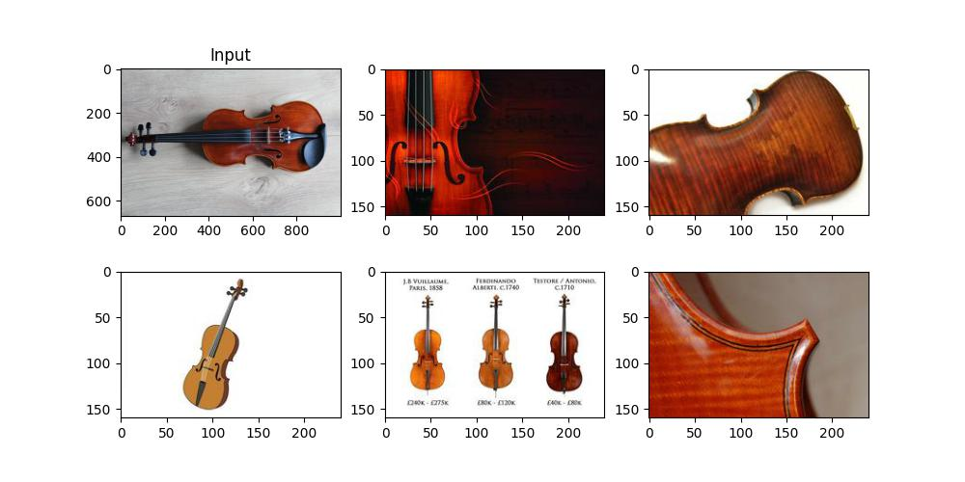
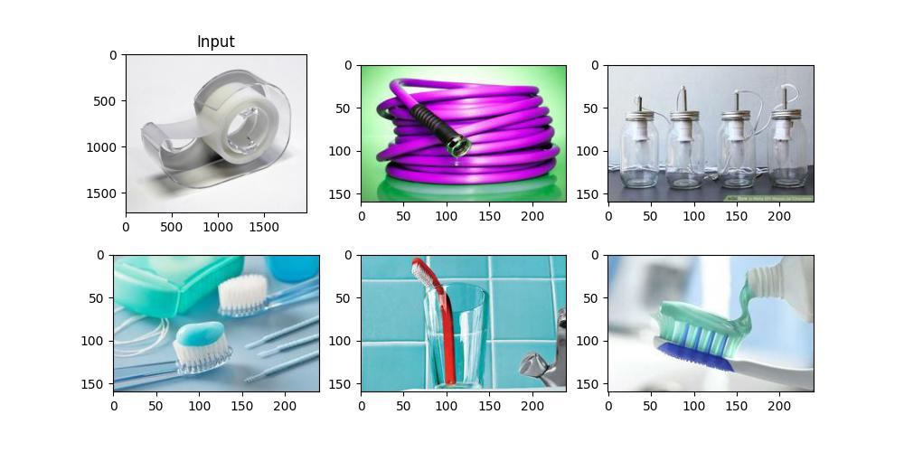
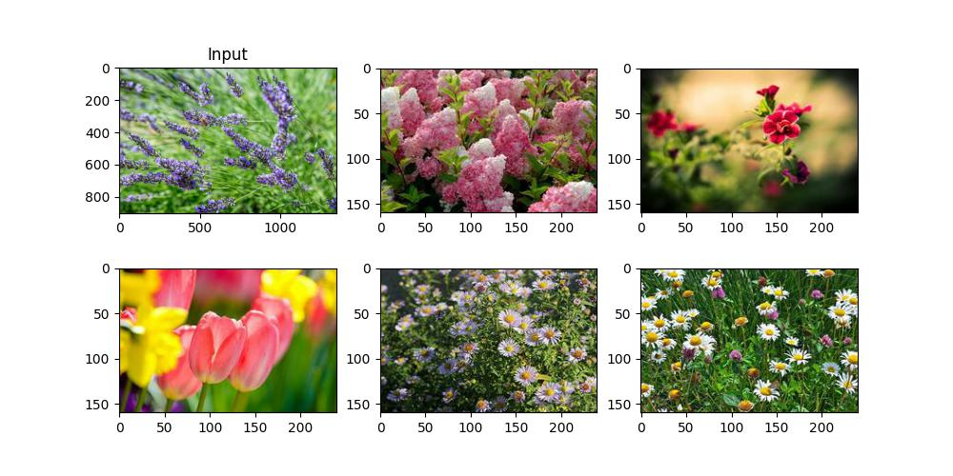
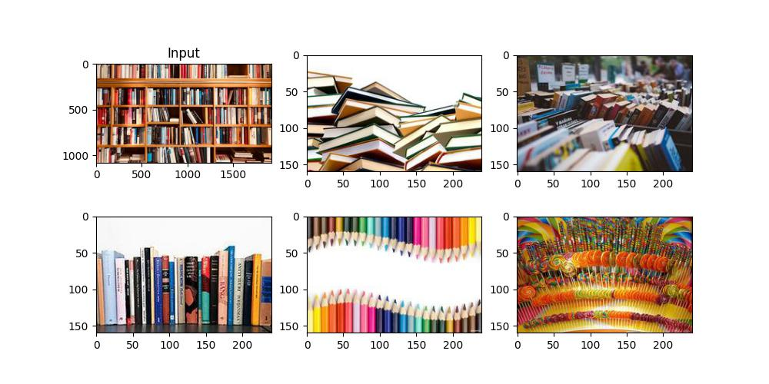
Outcome

Slide 4
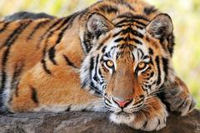
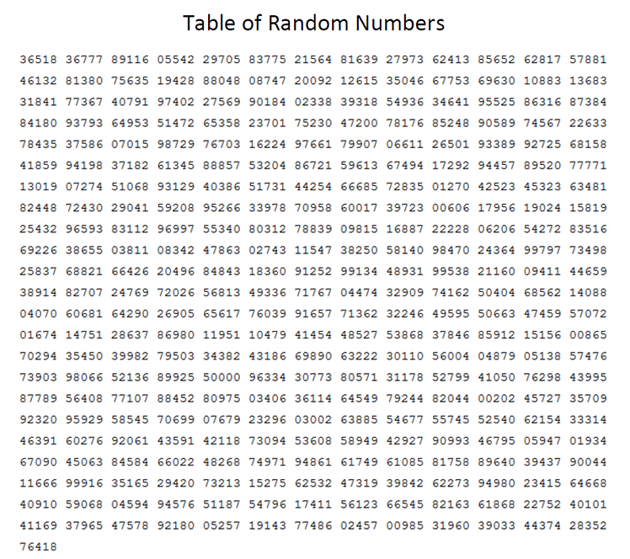
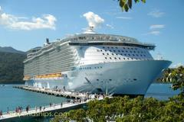
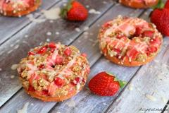
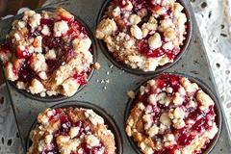



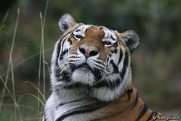
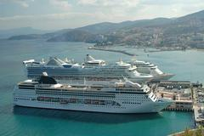
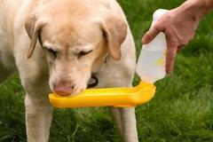
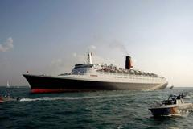
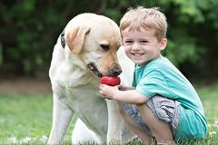
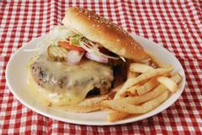
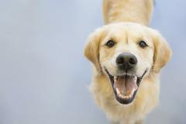
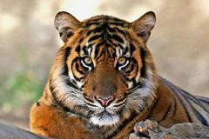
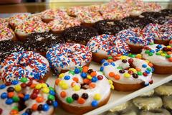
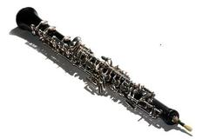
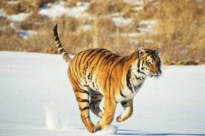

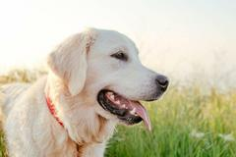
Method
Step 2. Embed Images
Step 1. Source Images
1. Source reference images
2. Embed reference images
3. Distance between embeddings
4. Cluster
5. Embed input image
6. Find nearest cluster
7. Check for duplicate
8. Return images from cluster
Notes:
Create ref dir:
Source Images
Explore/save images to reference directory
Embed those images
Cluster based on embeddings
Recommend:
Save input image
Embed image
Find nearest cluster
Return reference images from that cluster

Slide 5
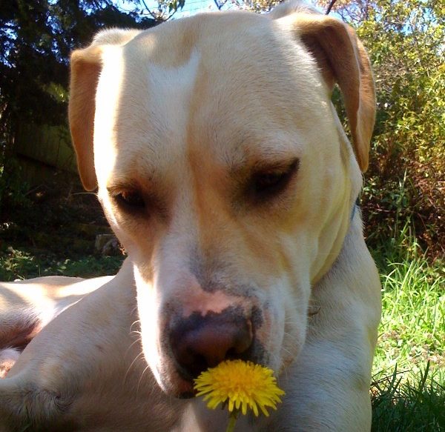
Method
Step 6. Find nearest cluster
Step 5. Embed input image
Step 4. Cluster
Step 3. Distance between images
2. Embed Images
4. Save input image
5. Embed image
6. Find nearest cluster
Notes:
$ python recommend_images.py return recommendation <path to input image> <path to reference images>

Slide 6
Method
Step 8. Return images
Step 6. Find nearest cluster
Step 7. Check for duplicates
1. Source reference images
2. Embed reference images
3. Distance between embeddings
4. Cluster
5. Embed input image
6. Find nearest cluster
7. Check for duplicate
8. Return images from cluster
7. Return images from that cluster
Notes:
$ python recommend_images.py return recommendation <path to input image> <path to reference images>

Slide 7

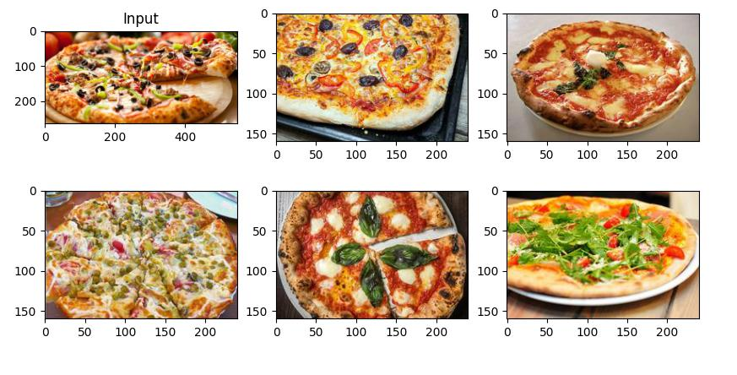
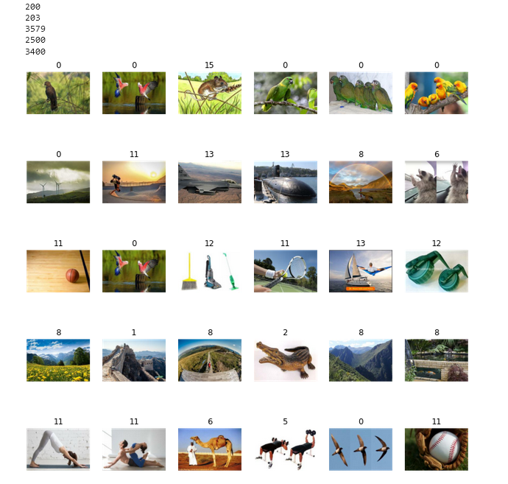
Challenges
Input

Slide 8
Conclusion

Slide 9
Thank you!

